Slide 1
License Plate Detection - using vertical gradients -
Cristian Militaru

Slide 2
Purpose
Input: camera image
Output: bounding box for each license plate
It is the first step in license number detection.
One application is automated ticketing of bad traffic conduit (e.g. passing intersection when traffic lights are red)

Slide 3
Features
High detection rate (about 90%)
Robust to illumination variations
Ability to detect multiple license plates

Slide 4
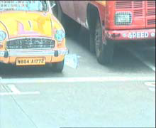
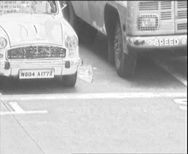
Step 1
Grayscale conversion:
gray(i, j) = 0.59 * R(i, j) + 0. 30 * G(i, j) + 0. 11 * B(i, j)

Slide 5
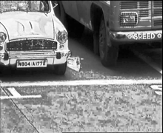

Step 2
Contrast stretch
K is the grey level in the left image, S_{k} is the grey level in the second one
N_{j} is the number of pixels with level j (from histogram)
N is the total number of pixels

Slide 6

Step 3
Edge gradients (using Sobel operator)
Make a binary image from edge gradients

Slide 7
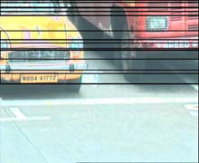
Step 4
Detect bands:
Find rows with many vertical edges
Compute mean and variance (of pixel positions) for each row
Find continuous rows with variance > V_{Threshold}

Slide 8
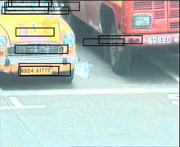
Step 5
Find left-right limits of each band
1. Find minimum and maximum x_{Average} of a row on the band;
2. Find the maximum variance of a row on the band;
3. Left = x_{AverageMin} – variance_{Max}; Right = x_{AverageMax} + variance_{Max}

Slide 9
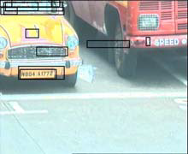
Step 6
Improve the left-right bounds of the regions:
Find the left-most and right-most prominent vertical lines
(which have the height > H_{Threshold})

Slide 10
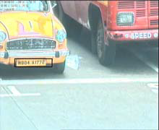
Step 7
Merge overlapping regions
Filter the regions by their area & aspect ratio

Slide 11
Possible issues
Can it detect more than one license plate on the same row of pixels?

Slide 12
Bibliography
Satadal Saha, Subhadip Basu, Mita Nasipuri, Dipak Kumar Basu, "License Plate Localization from Vehicle Images: An Edge Based Multi-stage Approach", International Journal of Recent Trends in Engineering, Vol 1, pp 284-289, 2009.
http://academypublisher.com/ijrte/vol01/no01/ijrte0101284288.pdf

